Slide 1


<Batuhan Umay>
<22.01.2022>

Slide 2

Outline
Executive Summary
Introduction
Methodology
Results
Conclusion
Appendix

Slide 3
Executive Summary
Summary of methodologies
Data Collection
Data Wrangling
EDA with Data Visualization
EDA with SQL
Interactive map with Folium
Dashboard with Plotly Dash
Predictive Analysis (Classification)
Summary of all results
EDA results
Interactive maps and dashboard
Predictive results

Slide 4
Introduction
Project background and context
Space X advertises Falcon 9 rocket launches on its website with a cost of 62 million dollars; other providers cost upward of 165 million dollars each, much of the savings is because Space X can reuse the first stage.
Problems you want to find answers
The project task is to predict if the first stage of the SpaceX Falcon 9 rocket will land successfully or not.

Slide 5

Section 1

Slide 6
Methodology
Executive Summary
Data collection methodology:
SpaceX Rest API
Web Scrapping from Wikipedia
Perform data wrangling
Dropping unnecessary columns
One Hot Encoding for classification models
Perform exploratory data analysis (EDA) using visualization and SQL
Perform interactive visual analytics using Folium and Plotly Dash
Perform predictive analysis using classification models
Logistic Regression, KNeighbors Classifier (KNN), Support Vector Classifier (SVM), Decision Tree Classifier

Slide 7
Data Collection
Describe how data sets were collected.
Datasets are collected from SpaceX Rest API and Webscrapping from Wikipedia.
You need to present your data collection process use key phrases and flowcharts
The SpaceX Rest API url: https://api.spacexdata.com/v4/
WebScrapping from Wikipedia url: https://en.wikipedia.org/w/index.php?title=List_of_Falcon_9_and_Falcon_Heavy_launches&oldid=1027686922
Use SpaceX Rest API
API retruns Json File
Make DataFrame usging Json File
Clean Data and Export it
Get HTML response from Wikipedia
Extract data with BeautifulSoup
Make DataFrame
Export Data

Slide 8
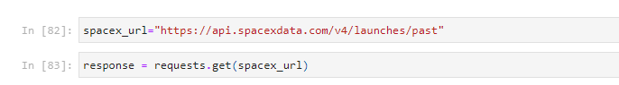
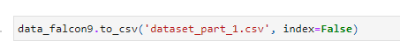
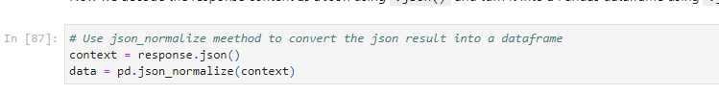
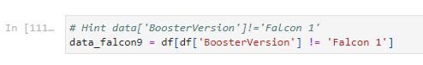
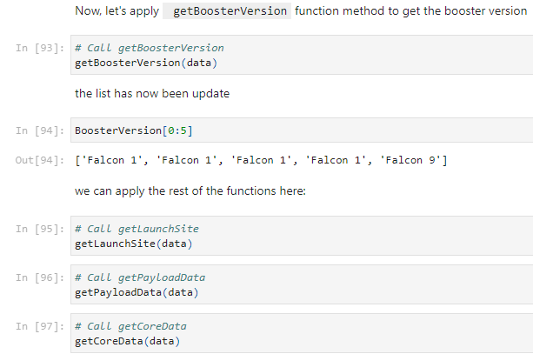
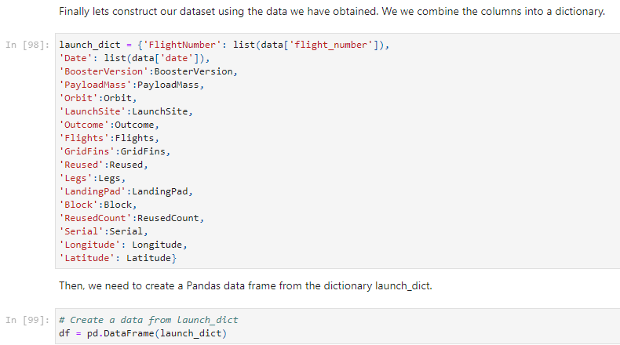
Data Collection – SpaceX API
1- Getting response from SpaceX Rest API
GitHub Link:
6- Export it
2- Decode response content as a json using .json() then turn it into a pandas dataframe using .json_normalize()
5- Use filter dataframe
3- Transform Data
4- Assing list to dictionary then pandas dataframe

Slide 9
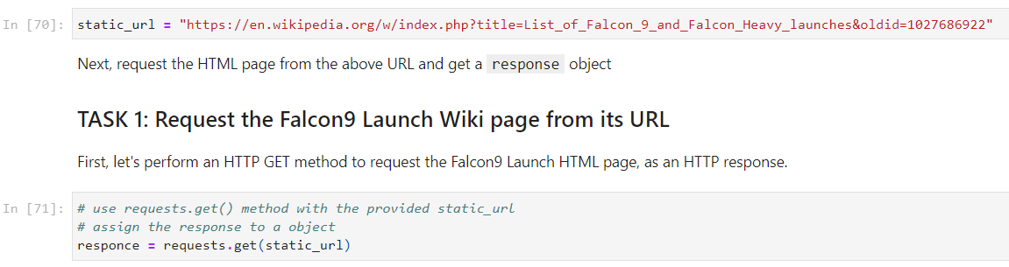
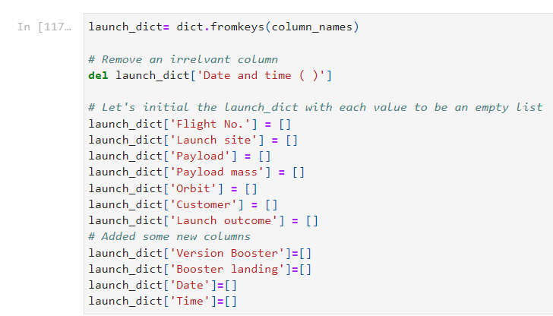
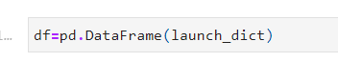
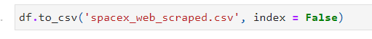
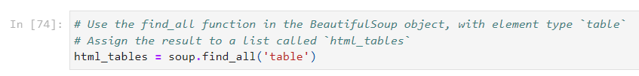
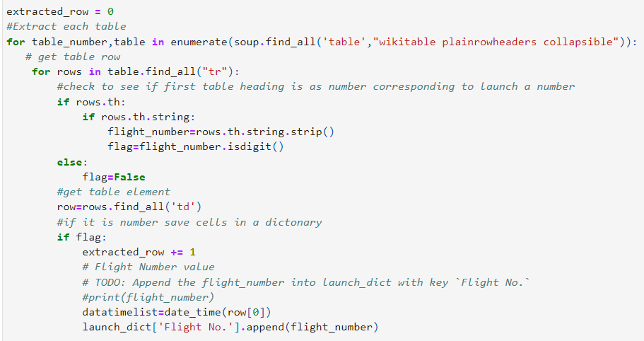
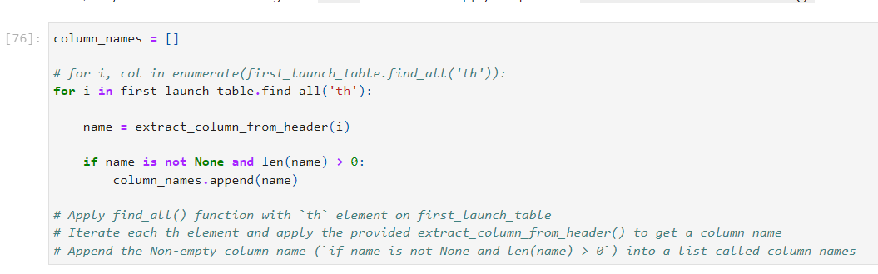
GitHub Link:
Data Collection - Scraping
1- Getting Response from Html Url
5- Creating dictionary
7- Creating dataframe from dictionary
2- Creating Beautiful Soup object
8- Export file as csv
3- Finding all tables
6- Add data to keys
4- Getting column names

Slide 10
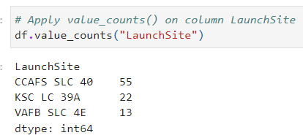
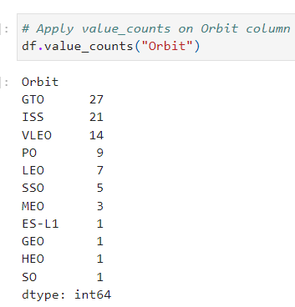
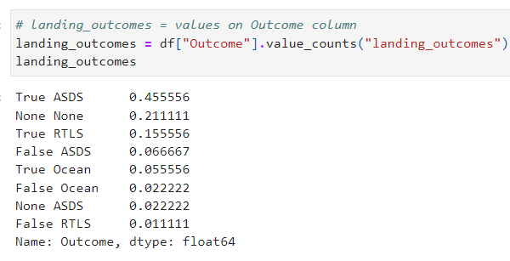
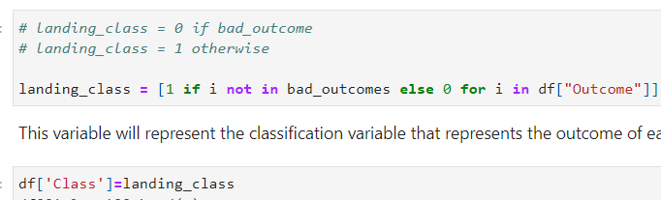
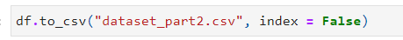
Data Wrangling
GitHub Link:
In the dataset, there are several cases where the booster didn’t land successully.
True Ocean, True RTLS, True ASDS means the mission has been successful.
False Ocean, False RTLS, False ASDS means the mission was a failure.
We need to transform string variables into categorical variables where 1 means the mission has been successful and 0 means the mission was a failure.
1- Calculate number of each launch sites
2- Calculate number of each orbit
3- Calculate number of landing outcomes
4-Create Class columns and assing 1 or 0 from landing outcome
5- Export file

Slide 11
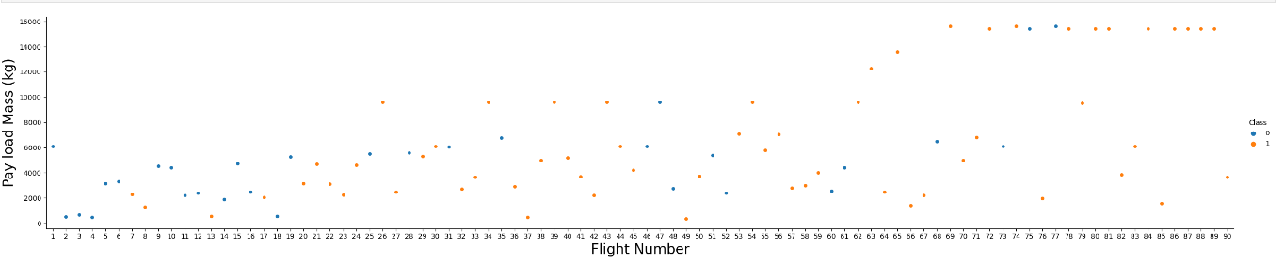
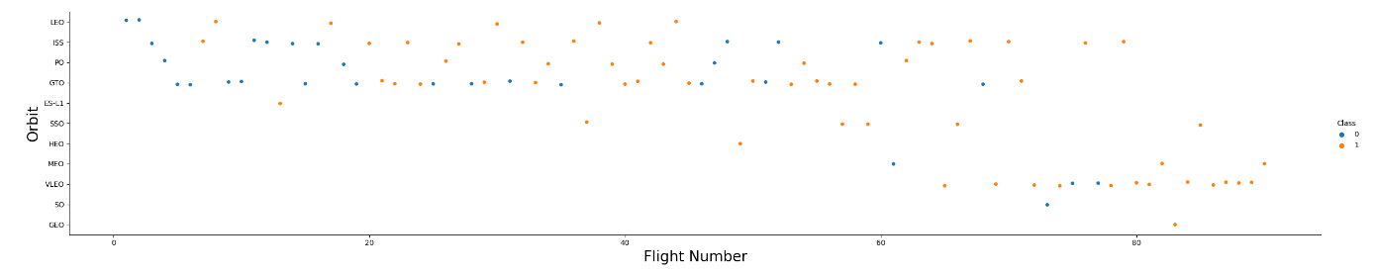
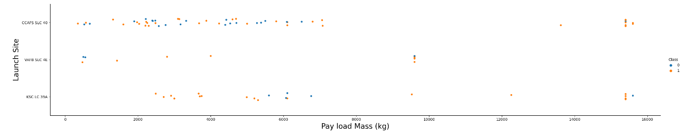
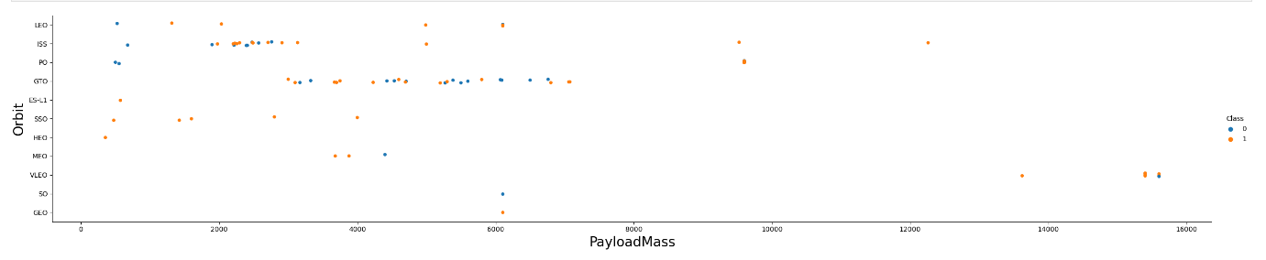
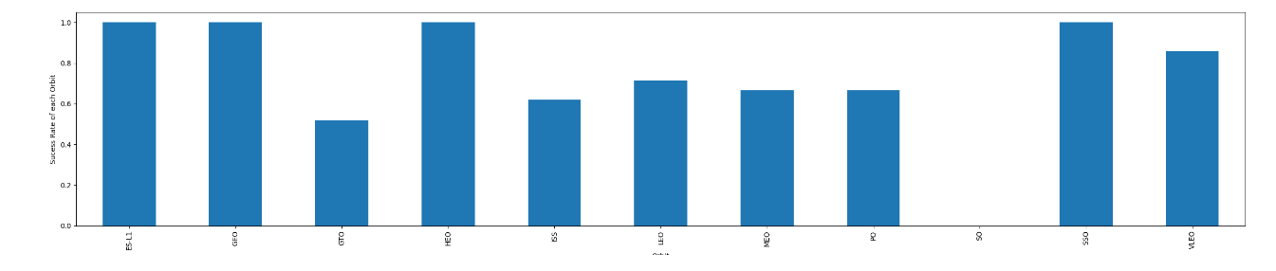
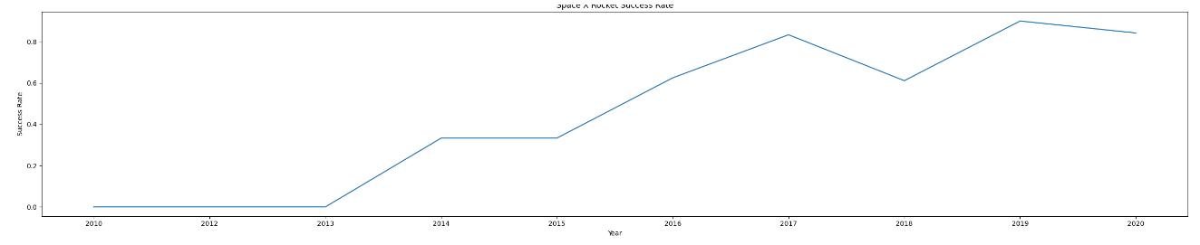
EDA with Data Visualization
GitHub Link:

Slide 12
GitHub Link:
EDA with SQL
Display the names of the unique launch sites in the space mission
Display 5 records where launch sites begin with the string 'CCA'
Display the total payload mass carried by boosters launched by NASA (CRS)
Display average payload mass carried by booster version F9 v1.1
List the date when the first successful landing outcome in ground pad was acheived.
List the names of the boosters which have success in drone ship and have payload mass greater than 4000 but less than 6000
List the total number of successful and failure mission outcomes
List the names of the booster_versions which have carried the maximum payload mass. Use a subquery
List the failed landing_outcomes in drone ship, their booster versions, and launch site names for in year 2015
Rank the count of landing outcomes (such as Failure (drone ship) or Success (ground pad)) between the date 2010-06-04 and 2017-03-20, in descending order

Slide 13
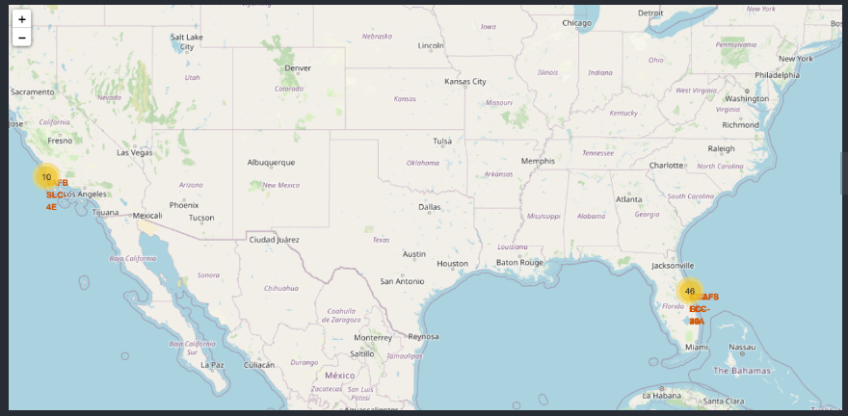
Build an Interactive Map with Folium
GitHub Link:
Folium map object is a map centered on NASA Johnson Space Center at Houston, Texas
Red circle at NASA Johnson Space Center's coordinate with label showing its name(folium.Circle, folium.map.Marker).
Red circles at each launch site coordinates with label showing launch site name (folium.Circle, folium.map.Marker, folium.features.DivIcon).
The grouping of points in a cluster to display multiple and different information for the same coordinates (folium.plugins.MarkerCluster).
Markers to show successful and unsuccessful landings. Green for successful landing and Red for unsuccessful landing. (folium.map.Marker, folium.Icon).
Markers to show distance between launch site to key locations (railway, highway, coastway, city) and plot a line between them. (folium.map.Marker, folium.PolyLine, folium.features.DivIcon)
These objects are created in order to understand better the problem and the data. We can show easily all launch sites, their surroundings and the number of successful and unsuccessful landings.

Slide 14
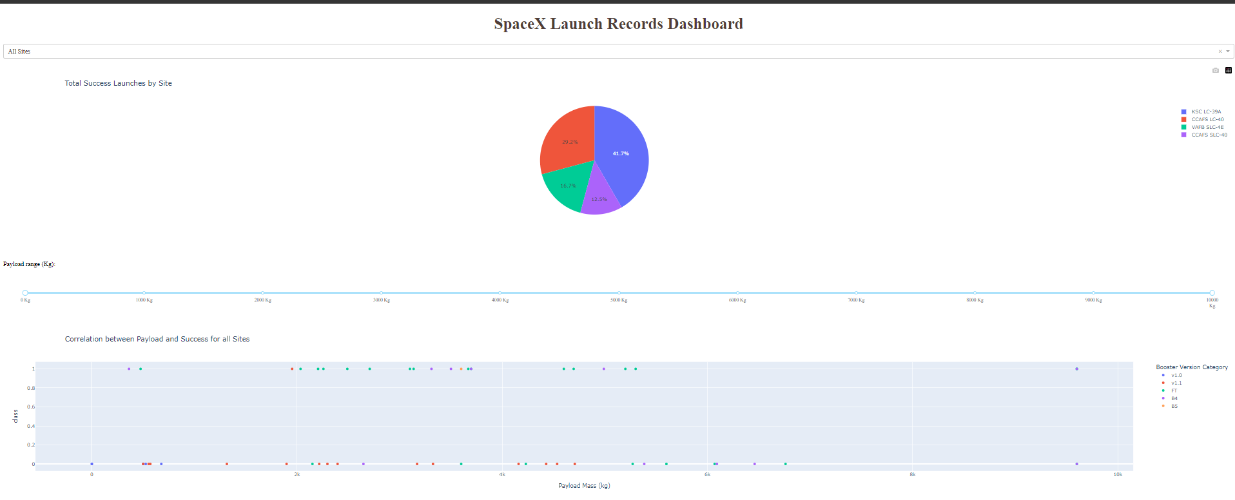
Build a Dashboard with Plotly Dash
Build a Dashboard with Plotly Dash
Dashboard has dropdown, pie chart, rangeslider and scatter plot components
Dropdown allows a user to choose the launch site or all launch sites (dash_core_components.Dropdown).
Pie chart shows the total success and the total failure for the launch site chosen with the dropdown component(plotly.express.pie).
Rangeslider allows a user to select a payload mass in a fixed range (dash_core_components.RangeSlider).
Scatter chart shows the relationship between two variables, in particular Success vs Payload Mass (plotly.express.scatter).
GitHub Link:

Slide 15
Predictive Analysis (Classification)
Predictive Analysis (Classification)
GitHub Link:
Data preparation
Load dataset
Normalize data
Split data into training and test sets.
Model preparation
Selection of machine learning algorithms
Set parameters for each algorithm to GridSearchCV
Training GridSearchModel models with training dataset
Model evaluation
Get best hyperparameters for each type of model
Compute accuracy for each model with test dataset
Plot Confusion Matrix
Model comparison
Comparison of models according to their accuracy
The model with the best accuracy will be chosen

Slide 16
Results
Decision Tree Classifier has higher test and train accuracy than SVM, KNN and Logistic Regression models.
Low weighted payloads perform better than heavier payloads.
The success rates for SpaceX launches is directly proportional time in years they will eventually perfect the launches.
KSC LC 39A had the most successful launches from all the sites.
Orbit GEO, HEO, SSO, ES l1 has the best Success Rate.

Slide 17

Section 2

Slide 18
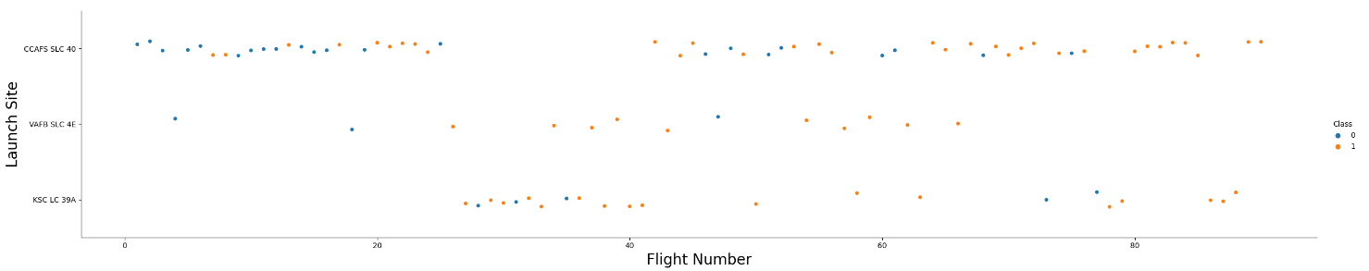
Flight Number vs. Launch Site
CCAFS SLC 40 are significantly higher than launches from other sites

Slide 19
Payload vs. Launch Site
Depending on the launch site, a heavier payload may be a consideration for a successful landing. On the other hand too heavy payload can make a landing fail.

Slide 20
Success Rate vs. Orbit Type
The orbit types of ES-L1, GEO, HEO, SSO have the best success rate.

Slide 21
Flight Number vs. Orbit Type
We notice that the success rate increases with the number of flights for the LEO orbit.

Slide 22
Payload vs. Orbit Type
The weight of the payloads can have a great influence on the success rate of the launches in certain orbits. For example, heavier payloads improve the success rate for the LEO orbit.

Slide 23
Launch Success Yearly Trend
Since 2013, we can see an increase in the SpaceX Rocket success rate.

Slide 24
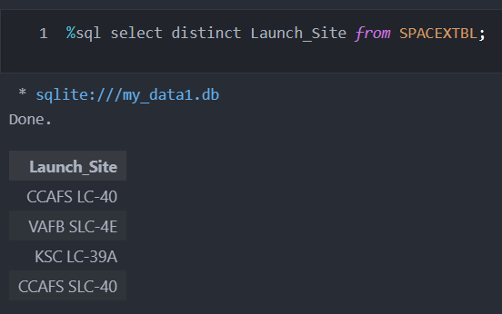
All Launch Site Names
The use of DISTINCT in the quert allows us to remove duplicate Launch_Site

Slide 25
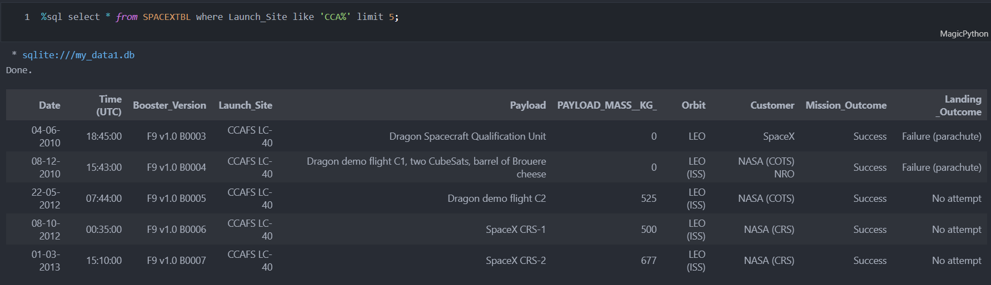
Launch Site Names Begin with 'CCA'
The WHERE clause followed by LIKE clause filters launch sites that contain the substring CCA. LIMIT 5 shows 5 records from filltering.

Slide 26
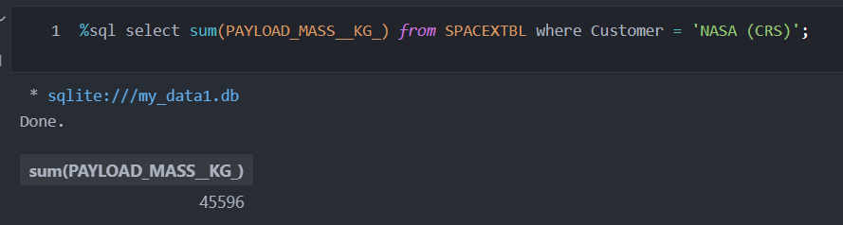
Total Payload Mass
This query return the sum of all PAYLOAD_MASS_KG_ where the Customer is NASA (CRS)

Slide 27
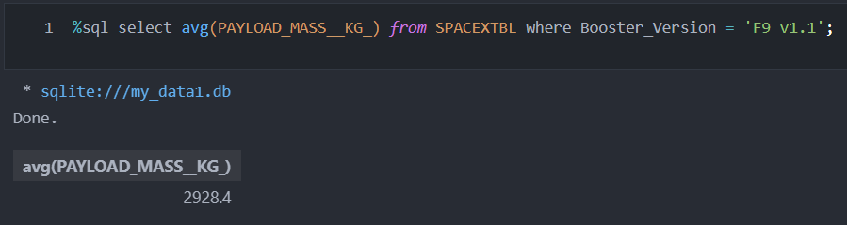
Average Payload Mass by F9 v1.1
This query returns the average of all PAYLOAD_MASS_KG_ where the Booster_Version contains the substring F9 V1.1

Slide 28
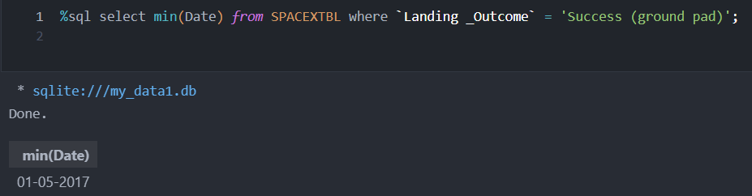
First Successful Ground Landing Date
This query shows the oldest successfel landing.
Where clause filters dataset

Slide 29
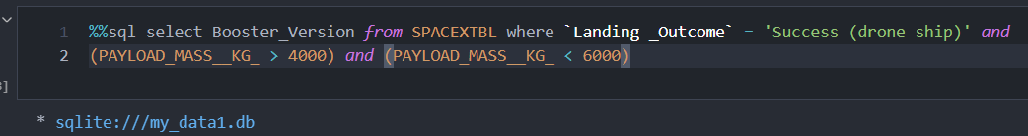
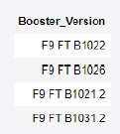
Successful Drone Ship Landing with Payload between 4000 and 6000
This query returns the Landing_Outcome was successful and PAYLOAD_MASS_KG_ between 4000 and 6000 kg

Slide 30
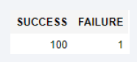
Total Number of Successful and Failure Mission Outcomes
With the first Select, we show the subqueries that return results. The first subquery counts the successful mission. The second subquery counts the unsuccessful mission.

Slide 31
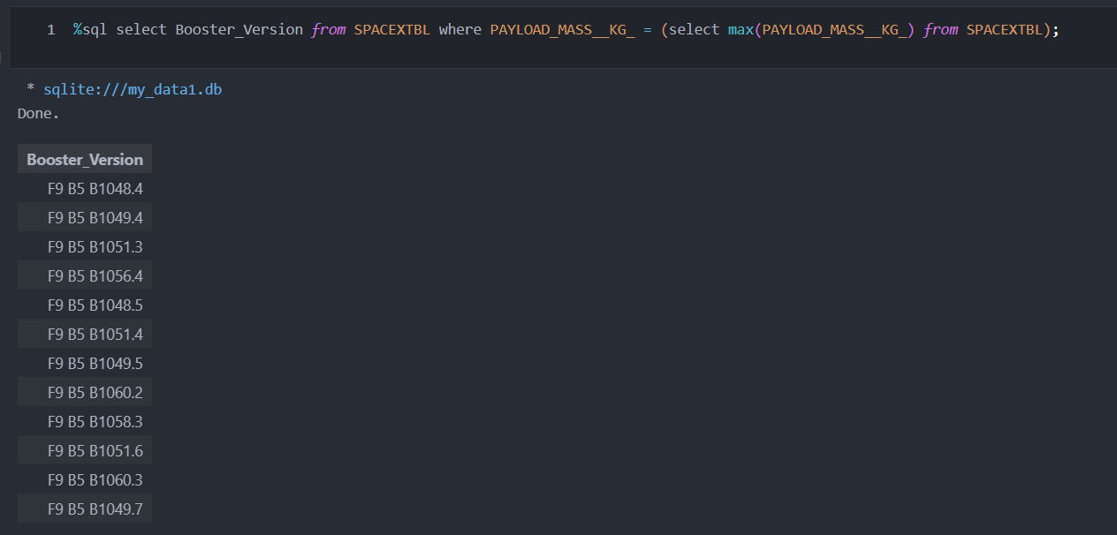
Boosters Carried Maximum Payload
We used subquery to filter data by returning the heaviest payload mass with Max function. The main query return Booster_Version with the heaviest payload mass

Slide 32
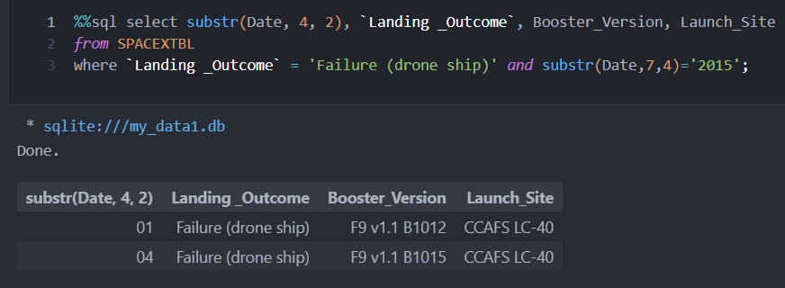
2015 Launch Records
Substr(Date, 4, 2) shows month. Substr(Date, 7, 4) shows year.
This query returns landing was unsuccessfull and landing date in 2015

Slide 33
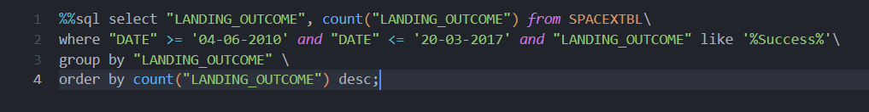
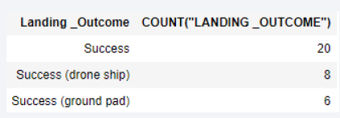
Rank Landing Outcomes Between 2010-06-04 and 2017-03-20
This query return mission was successful and date between 2010-06-04 and 2017-03-20.

Slide 34

Section 3

Slide 35
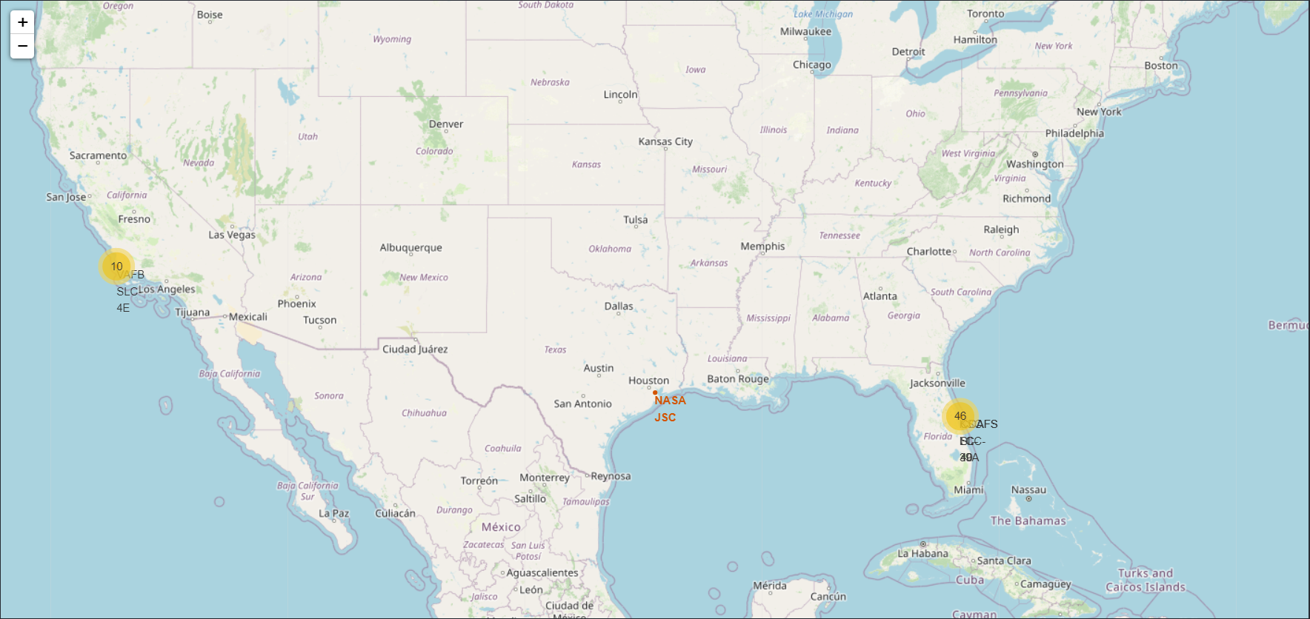
<Folium Map - Ground stations >
We see that SpaceX launch sites are located on the coast of the USA

Slide 36
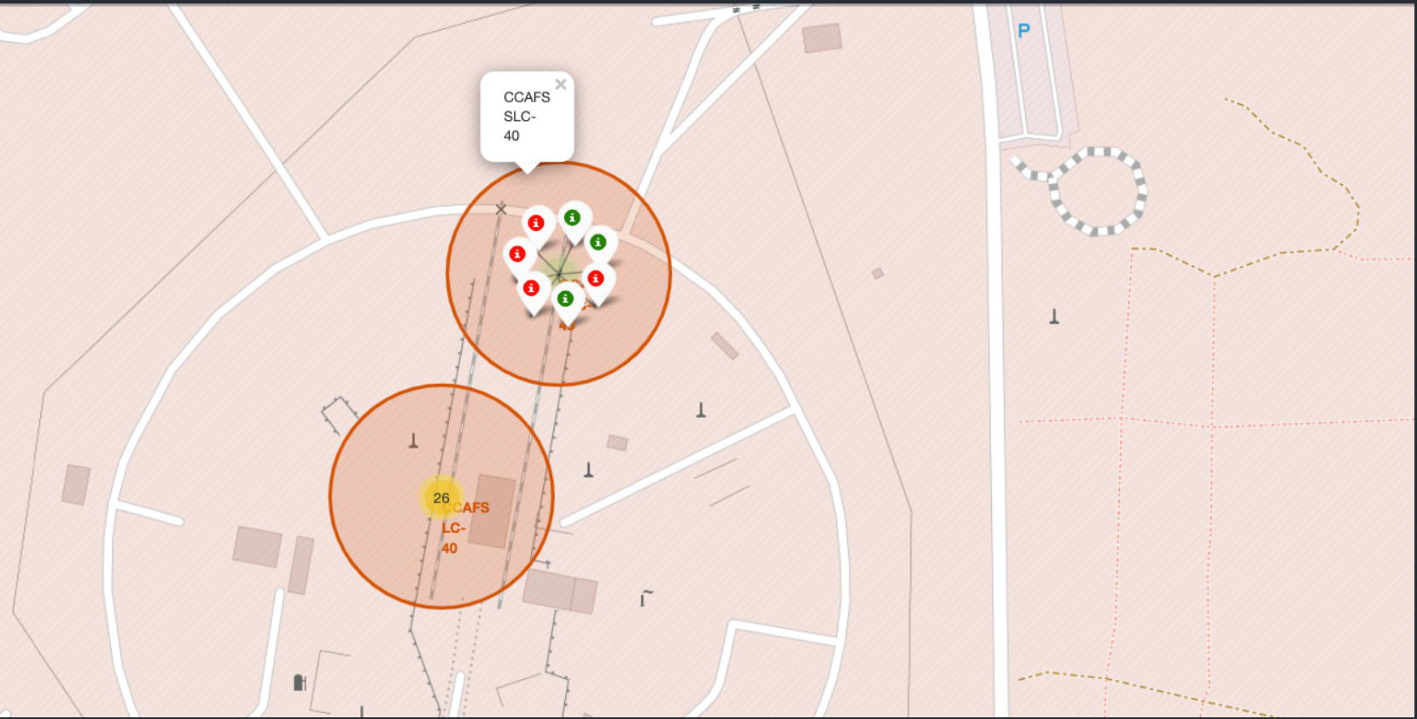
<Folium Map - Color Labeled Markers >
Green markers represent successful launches.
Red markers represent unseccessful launches

Slide 37

<Folium Map –Distances between CCAFS SLC-40 and its proximities >
Is CCAFS SLC-40 in close proximity to coastline?
Yes

Slide 38

Section 4

Slide 39
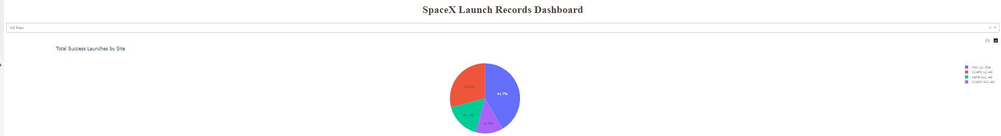
<Dashboard - Total success by Site >
KSC LC-39A has best success rate of launches

Slide 40
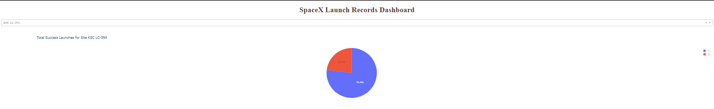
<Dashboard –Total success launches for Site KSC LC-39A >
KSC LC-39A has achieved a 76.9% success rate and 23.1% failure rate.

Slide 41
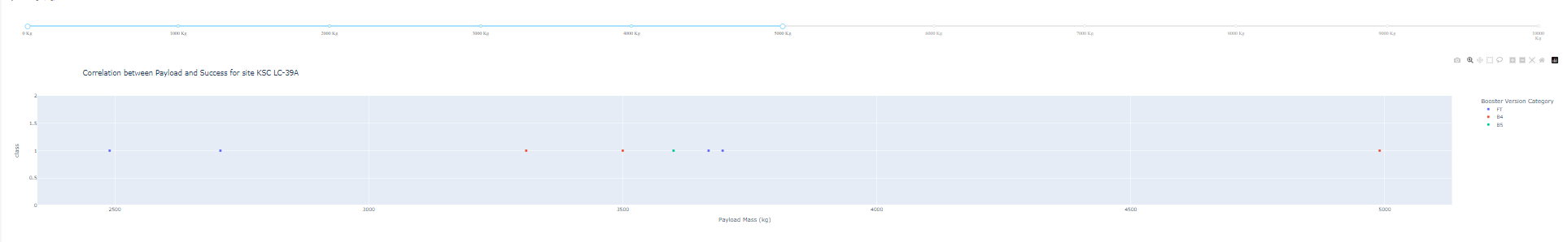
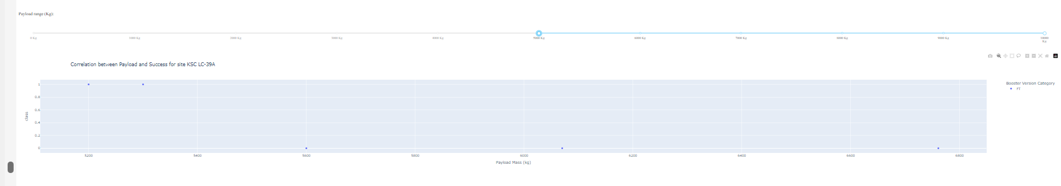
<Dashboard -Payload mass vs Outcome for all sites with different payload mass selected >
Low weighted payloads have a better success rate than the heavy weighted payloads

Slide 42

Section 5

Slide 43
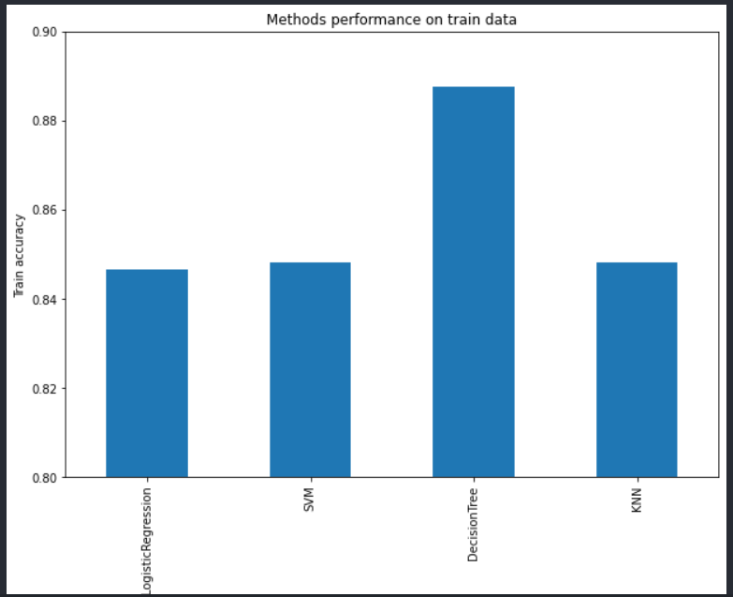
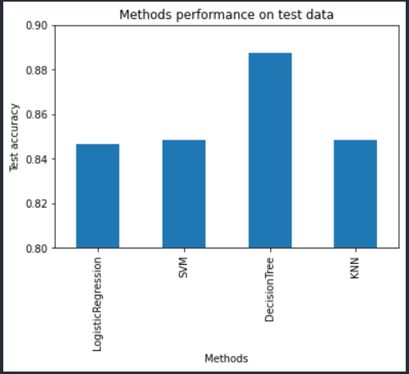
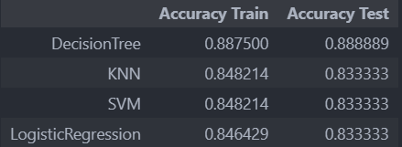
Classification Accuracy
For accuracy scores are both test and train graphics are so similar. If we want to choose a model we could take the Decision Tree Classifier.

Slide 44
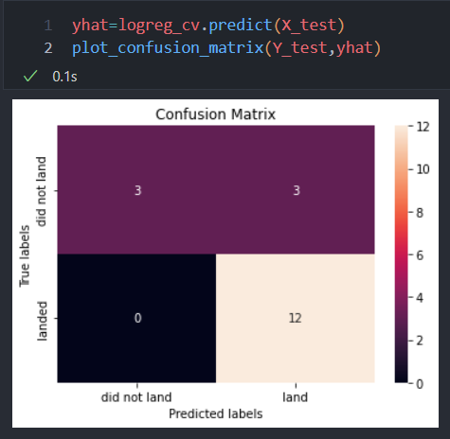
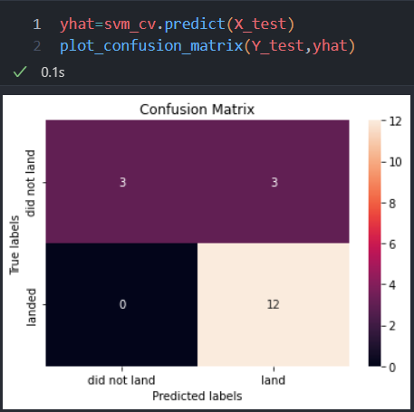



Confusion Matrix
SVM, KNN, Logistig Regression have same rate on TP, FP, FN, TN
Decision Tree has better accuracy.Because TP + TN higher than other models.
The main problem of these 3 models are False Positives (FP)

Slide 45
Conclusions
Decision Tree model is the best in terms of prediction accuracy for this dataset.
Low weighted payloads perform better than the heavier payloads.
KSC LC 39A had the most successful launches from all the sites
Orbit GEO, HEO, SSO, ES L1 have the best success rate.
The success of a mission can be explained by several factors such as the launch site, the orbit and especially the number of previous launches. Indeed, we can assume that there has been a gain in knowledge between launches that allowed to go from a launch failure to a success.
Depending on the orbits, the payload mass can be a criterion to take into account for the success of a mission. Some orbits require a light or heavy payload mass. But generally low weighted payloads perform better than the heavy weighted payloads.
With the current data, we cannot explain why some launch sites are better than others (KSC LC-39A is the best launch site). To get an answer to this problem, we could obtain atmospheric or other relevant data.

Slide 46

Appendix
We add this code block to hide some warnings

Slide 47


